Slide 1
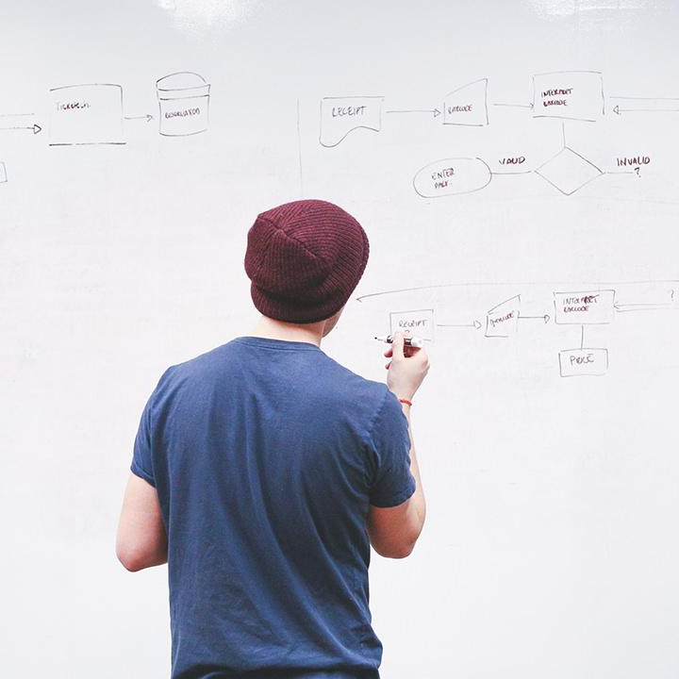
HELLO!
Here 1Crore Projects
I am here because I love to give presentations.
You can find me at @1CROREPROJECTS

Slide 2
A Trusted Blockchain-Based Traceability System for Fruit and Vegetable Agricultural Products

Slide 3

AIM OF PROJECT
The main aim of the project to designs a traceability system based on blockchain technology for storage and query of product information in supply chain of agricultural products.

Slide 4
ABSTRACT
Traditional traceability system has problems of centralized management, opaque information, untrustworthy data, and easy generation of information islands. To solve the above problems, this paper designs a traceability system based on blockchain technology for storage and query of product information in supply chain of agricultural products.
Leveraging the characteristics of decentralization, tamper-proof and traceability of blockchain technology, the transparency and credibility of traceability information increased.

Slide 5
INTRODUCTION
Fruit and vegetable agricultural products have excellent production advantages in China, which is a large agricultural country with superior climate conditions and abundant species resources. According to data from the National Bureau of Statistics of China .The total output of fruit and vegetable agricultural products in 2019 was 995.03 million tons, accounting for 54.48% of all agricultural products (1826.55 million tons). Fruit and vegetable agricultural products have the characteristics of green, healthy and high nutritional value . which are deeply loved by people

Slide 6
EXISTING SYSTEM
In our existing system a complex issue because of perishability factor. Farmers producing fruits and vegetables, market it only after consumption. There are heavy post-harvest and handling losses, resulting in low productivity per unit area and high cost of production.
Traditional traceability system has problems of centralized management opaque information, untrustworthy data, and easy generation of information.

Slide 7
DISADVANTAGES
Security issues
Late Delivery of online vegetables
The personal touch is very less.
Internet bandwidth

Slide 8
PROPOSED SYSTEM
In this we proposed to designs a traceability system based on blockchain technology for storage and query of product information in supply chain of agricultural products
We provide performance analysis and practical application, the results show that our system improves the query efficiency and the security of private information.

Slide 9
ADVANTAGES
High security.
Traffic and crowd can be avoided.
Time saved
Saves money

Slide 10
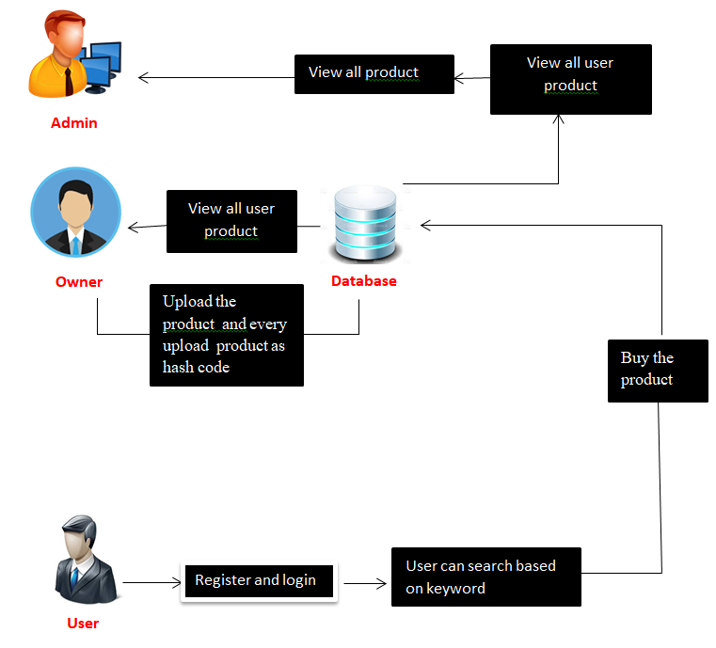
SYSTEM ARCHITECTURE

Slide 11
MODULES
In this project has three modules:
Admin
Data owner
User

Slide 12
ADMIN
Login the account with correct username and Password
Admin can authorize owner and user
View all product
View all user product
Graph
Logout

Slide 13
DATA OWNER
Register the account with the basic information
After authorize by admin owner can login the account
Upload the products with encrypt format
Block chain: Every uploaded product have hash code and block
View all upload product
View all purchased user
Logout

Slide 14
USER
Register the account with the basic information
After authorize by admin owner can login the account
User can search the product based on keyword
User can purchase the product
logout

Slide 15
HARDWARE REQUIREMENTS
System | Intel i3 and above
Hard Disk | 40GB
RAM | Minimum 4GB
Processor | 64-bit, four-core, 2.5 GHz minimum per core

Slide 16
SOFTWARE REQUIREMENTS
Front End Language | HTML, CSS, JAVA, JSP SERVELTS
Backend | My SQL
Operating System | Windows 10 or 11
IDE | JAVADEVELIPEMENKIT

Slide 17
FUTURE WORK
In our future work we will further explore the cross-chain technology between multiple chains and a new type of consensus mechanism suitable for traceability.

Slide 18
CONCLUSION
In this project, we designed and implemented the traceability system of fruits and vegetables agricultural products based on the non-tampering and traceable characteristics of blockchain, and discussed the storage and query design of the system. To overcome the problems of high data load pressure and poor private security of the blockchain traceability system as the data grows, an on-chain and off-chain data storage method using ‘‘database + blockchain’’ is proposed. The public information displayed to consumers is stored in the supply chain to the local database, whose hash value by SHA256 algorithm was upload to the blockchain system.

Slide 19
REFERENCE
[1] NBSC National Bureau of Statistics of China. (2019). National Data. [Online]. Available: https://data.stats.gov.cn/
[2] G. Francois, V. Fabrice, and M. Didier, ‘‘Traceability of fruits and vegetables,’’ Phytochemistry,vol.173,May2020,Art.no.112291,doi: 10.1016/j.phytochem.2020.112291.
[3] J. Hu, X. Zhang, L. M. Moga, and M. Neculita, ‘‘Modeling and implementation of the vegetable supply chain traceability system,’’ Food Control, vol. 30, no. 1, pp. 341–353, Mar. 2013, doi: 10.1016/j. foodcont.2012.06.037.

Slide 20
THANKS!
Any questions?
You can find me at
Reach us – 1croreprojects@gmail.com
Contact / Whatsapp: 7708 150 152 / 9751 800 789 / 790 432 0834

